Slide 1
Basic Foundation: Standards, Models, and Languages

Slide 2
Outline
NM Standards
Organization Model
Information Model
Communication Model
Functional Model
ASN.1
BER Encoding
Macro

Slide 3
Introduction
Standards
Standards organizations
Protocol standards of transport layers
Protocol standards of management (application) layer
Management Models
Language
Notes:
We learned about network technology and components that need to be managed. There are several management standards and models in existence for managing networks, systems, and services. We can understand and appreciate them better by first looking at the commonality among them, and then the differences that distinguish them. These goals form the objectives of this chapter.
The two leading models of network management is the lnternet model and the Open System interconnection (OSI model.) The lntemet model is the most widely used for network management.. It is a. simple scalar model and hence easy to implement. The OSI model, which is object oriented, is more complex and harder to implement.
However, with the matured stage of object-oriented technology. and the convergence of data and telecommunications technologies, object-oriented implementation of network management has come into vogue.

Slide 4
1. NM Standards
Notes:
Table 3.1 Four standards, along with a fifth class based on emerging technologies, and their salient points.
The first four are the OSI model, the Internet model, TMN, and IEEE LAN/MAN.
The first category in Table 3.1. Open System Interconnection (OSI) management standard, is the standard adopted by the Iotemational Standards Organization (ISO).
The OSl management protocol standard is Common Management Information Protocol (CMIP). The OSI management protocol bas built-in services, Common Management information Service (CMIS), which specify the basic services needed to perform the various functions.
It is the most comprehensive set of specifications and addresses all seven layers.
OSI specifications are structured and deal with all seven layers of the OSI Reference Model. The specifications are object oriented and hence managed objects are based on object classes and inheritance rules.
Besides specifying the management protocols, CMlP/CMIS also address network management applications. Some oft he major drawbacks of the OSI management standard were that it was complex and that the CMIP stack was large.

Slide 5
NM Standards (cont.)
Notes:
The third category in Table 3. I, TMN, is designed to manage the telecommunications network and is oriented towards the need of telecommunications service providers. TMN is ITU-T (International Telecommunications Union-Telecommunications) standard and is based on OSI CMIP/CMIS specifications.
TMN extends the concept of management beyond managing networks and network components. Its specifications address service and
business considerations.
The IEEE standards for Local Area Network (LAN) and Metropolitan Area Network (MAN) specifications shown in Table 3.1 are only concerned with OSI layers 1.(physical) and 2 (data link) .
Those specifications are structured similar to the OSI specifications. Botb OSI/CMIP and INTERNET/SNMP protocols use IEEE standards for the lower layers.
lEEE 802.x (series of specifications define the standards for the various physical media and data link protocols.
lEEE 802.x specifications present overview, architecture, and management.
The IEEE 802.2 standard specifies the Logical Link Control (LLC) layer.
The LLC layer provides transparency off be various physical media and protocols to the network layer.
The last category in Table 3.1 addresses several emerging management technologies. One of them is based on using Web technology. Web server for the management system and Web browsers for network management stations.
ln Web-based management, the organzation model uses Web server-Web browser architecture. Much of the object-oriented technology, such as hypermedia server, CORBA-oriented transportation, and client- server push-technology influence the Web-based management.
The Web-Based Enterprise Management (WBEM) standard is developed by the Desktop .Management Task Force (DMTF). It is based on the Common information Model (CIM) data model transported using CIM Operations over HTTP.
The Java Management Extension [JMX] is an open Java technolo.gy for management. It defines management architecture, application programming interfaces (APls). and management of services under a single umbrella specification. It was developed under Sun Microsystems’s. JMAPI. (Java Management API) initiative.

Slide 6
OSI Architecture and Model
Notes:
The OSI network model is an ISO standard and is most complete of all the models. lt is structured and it addresses all aspects of management.
Figure 3.1 shows an OSl network management architectural model that comprises four models. They are the organization model. the information model. the communication model. and the functions model.
Although, the above classification is based on the OSI architectural model, and only parts of it are applicable to other models, it helps us understand the holistic picture of different aspects of network management.

Slide 7
OSI NM
Organization Model
Network management components
Functions of components
Relationships
Information Model
Structure of management information (SMI)
Syntax and semantics
Management information base (MIB)
Organization of management information
Object-oriented
Notes:
The organization model describes the components of a network management system, their functions, and their infrastructure. The organization model is defined in ISO 10040 OSI Systems Management Overview. It defines the terms object, agent, and manager.

Slide 8
OSI NM
Communication Model
Transfer syntax with bi-directional messages
Transfer structure (PDU)
Functional Model
Application functions
Configure components (CM)
Monitor components (FM)
Measure performance (PM)
Secure information (SM)
Usage accounting (AM)

Slide 9
SNMP Architecture and Model
Organization Model
Same as OSI model
Information Model
Same as OSI, but scalar
Communication Model
Messages less complex than OSI and unidirectional
Transfer structure (PDU)
Functional Model
Application functions
Operations
Administration
Security

Slide 10
TMN Architecture
Addresses management of telecommunication networks
Based on OSI model
Superstructure on OSI network
Addresses network, service, and business management

Slide 11
TMN & Telecommunication network

Slide 12
2. Organization Model
Describes the components of network management and their relationships.
NM Components
Manager
Agent
Managed Objects

Slide 13
NM Components
Manager
Sends requests to agents
Monitors alarms
Houses applications
Provides user interface
Agent
Gathers information from objects
Configures parameters of objects
Responds to managers’ requests
Generates alarms and sends them to mangers
Managed object
Network element that is managed
Houses management agent
All objects are not managed / manageable

Slide 14
Two-Tier NM Organization Model
Notes:
The manager manages the managed element As shown in Figure 3.2, there is a database in the manager, bun not in the agent The manager queries and receives management data from the agent, processes them. and stores them in its database. The agent can also send a minimal set of alarm information to the manager unsolicited.

Slide 15
Three-Tier Model
Notes:
Figure 3.3 presents a three-tier configuration. The intermediate layer acts as both agent and manager. As manager, it collects data from the network elements, processes them, and stores the results in .its database. As agent. it transmits information to the top-level manager.
For example, an intermediate system is used for making statistical measurements on a network and passes the information as needed to the top-level manager. Alternatively, an intermediate NMS could be at a site of a network and the information is passed on to a remote site.

Slide 16
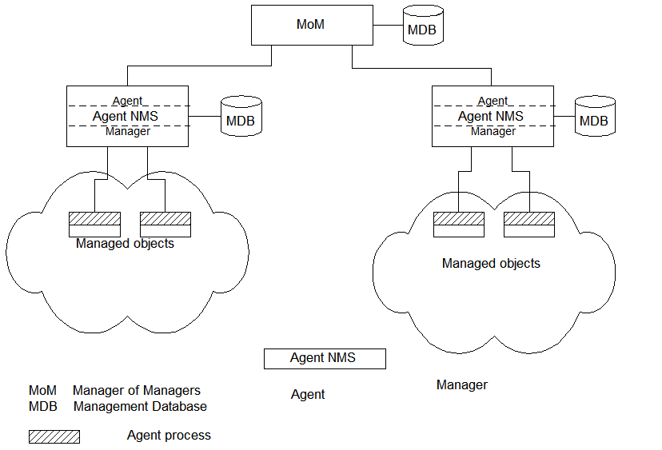
NM Organization Model with MoM
Notes:
Network domains can be managed locally and a global view of the networks can be monitored by a Manager of Managers (MoM), as shown in Figure 3.4. This configuration uses an enterprise NMS and is applicable to organizations with sites distributed across cities. It is also applicable to a configuration where vendor management systems manage the domains of their respective components, and MoM manages the entire network.

Slide 17
Peer NMSs
Dual Role of Management Process
Notes:
Network management systems can also be configured on a peer-to-peer relationship as shown in Figure 3.5. It is the dumbbell architecture shown in figure 1.24. We can recognize the similarity between this and the client-server architecture where a host serves as both a client and a server. An example of such a situation would be two network service providers needing to exchange management information between them. From the user's point of view, the information traverses both networks and needs to be monitored end-to-end.

Slide 18
3. Information Model
Structure and Storage of Management Information
SMI (Structure of Management Information)
Defines the syntax and semantics of management information.
MIB (Management Information Base)
Conceptual storage of management information
Notes:
An information model is concerned with the structure and storage of information. Let us consider, for example, how information is structured and stored in a library and is accessed by all.
A book is uniquely identified by an International Standard Book Number (ISBN). It is a ten-digit number identification that refers to a specific edition of a specific book. For example. ISBN 0-13-437708-7 refers to the book "Understanding SNMP MlBs" by David Perkins and Evan McGinnis. We can refer to a specific figure in the book by identifying a chapter number and a figure number; e.g., Fig. 3.1 refers to figure I in Chapter 3. Thus, a hierarchy of designation {ISBN, Chapter, Figure} uniquely identifies the object, which is a figure in the book. "ISBN," "Chapter," and "Figure" define the syntax of the three pieces of information associated with the figure; and the definition of their meaning in a dictionary would be the semantics associated with them.

Slide 19
SMI (Structure of Management Information)
SMI defines for a managed object
Syntax
Semantics
plus additional information such as status
Example sysDescr: { system 1 } Syntax: OCTET STRING Definition: "A textual description of the entity. " Access: read-only Status: mandatory

Slide 20
Management Information Base (MIB)
Information base contains information about objects
Organized by grouping of related objects
Defines relationship between objects
It is NOT a physical database. It is a virtual database that is compiled into management module.
Agent MIB vs. Manager MIB ➔ MIB View

Slide 21
MIB View: An Analogy
A County library system has many branches
Each branch has a set of books
The books in each branch is a different set
The information base of the county has the view (catalog) of all books
The information base of each branch has the catalog of books that belong to that branch. That is, each branch has its view (catalog) of the information base
Let us apply this to MIB view

Slide 22
MIB View and Object Access
A managed object has many attributes - its information base
There are several operations that can be performed on the objects
A user (manager) can view and perform only certain operations on the object by invoking the management agent
The view of the object attributes that the agent perceives is the MIB view
The operation that a user can perform is the MIB access

Slide 23
MDB vs. MIB
MDB
Management Data Base
physical database
MIB
Management Information Base
virtual database
Notes:
Figure 3.6 expands the net.,vork configuration that is shown in Figure 3.2 to include the MlB that is associated with the manager. Thus, the manager has both the management database (MDB) and the MIB. It is important to distinguish between the two. The MOB is a real database and contains tbe measured or adm.inistrotively configured value of the elements of the network. On the other hand, the MIS is a virtual database and contains the infOrmation necessary for processes to exchange infonnation among themselves.

Slide 24
Managed Objects (MOs) in MIB
Managed objects can be
Network elements (hardware, system)
hubs, bridges, routers, transmission facilities
Software (non-physical)
programs, algorithms
Administrative information
contact person, name of group of objects (IP group)

Slide 25
Management Information Tree (MIT)
MOs are uniquely defined by a tree structure specified by OSI model.

Slide 26
OSI Management Information Tree
Designation:
iso 1
org 1.3
dod 1.3.6
internet 1.3.6.1

Slide 27
Three Trees in Network Management
Inheritance Tree
NE / Switch / Ethernet Switch
Containment Tree
NE / Module / Interface / Physical Address
Registration Tree
iso / org / dod / internet / management

Slide 28
Object Type and Instance
Each object type has a unique identification (Object Identifier, OID) and name (Descriptor).
Object Type
Name
Syntax
Definition
Status
Access
Object Instance
Each object type has one or more instances.
sysName
Octet String
“The name of a system”
Mandatory
Read-Only

Slide 29
Managed Object: Internet Perspective

Slide 30
Managed Object: Internet Perspective
object ID unique ID (OID)
and descriptor and name for the object
syntax used to model the object
access access privilege to a managed object
status implementation requirements
definition textual description of the semantics of object type
References: RFC 1155, RFC 1212

Slide 31
Managed Object: OSI Perspective

Slide 32
Managed Object: OSI Perspective
object class managed object
attributes attributes visible at its boundary
operations operations which may be applied to it
behavior behavior exhibited by it in response
to operation
notifications notifications emitted by the object

Slide 33
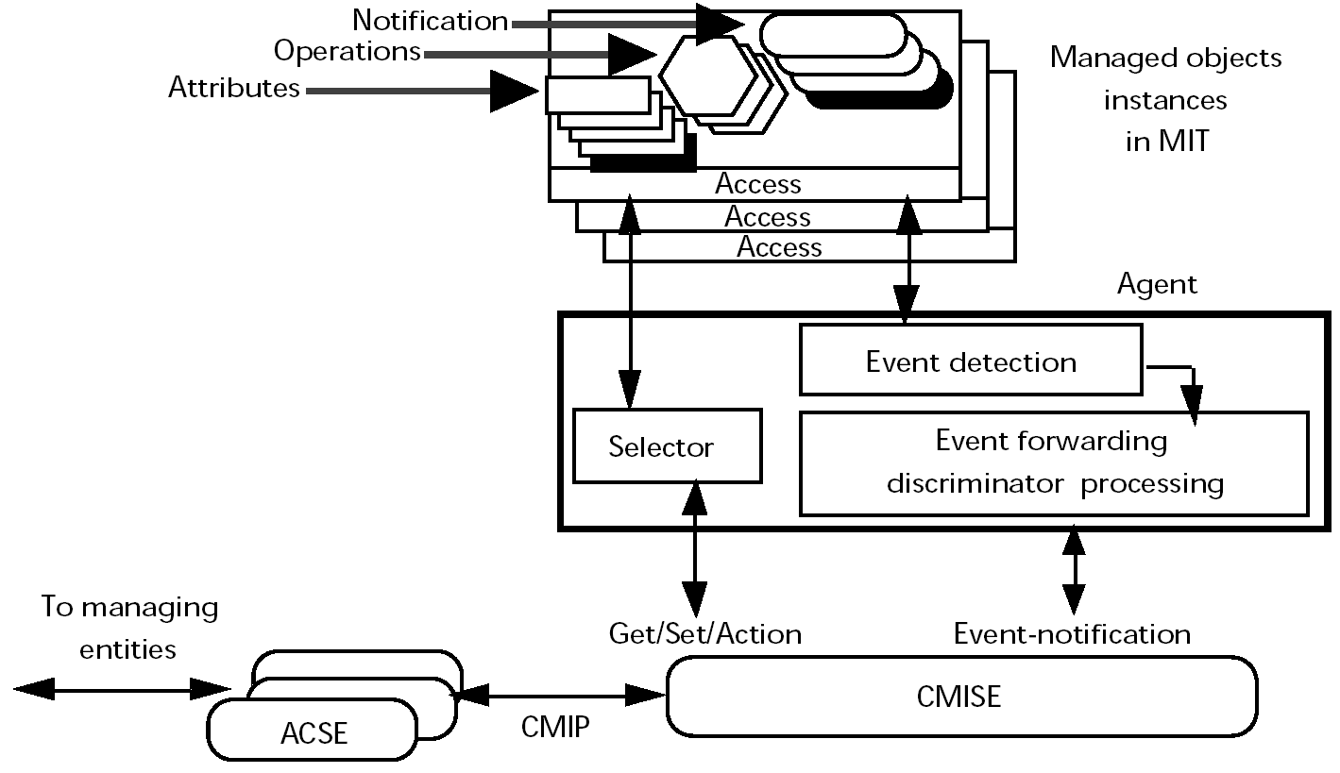
Managed information communication architecture.
Source: IEEE Communications Magazine • May 1993

Slide 34
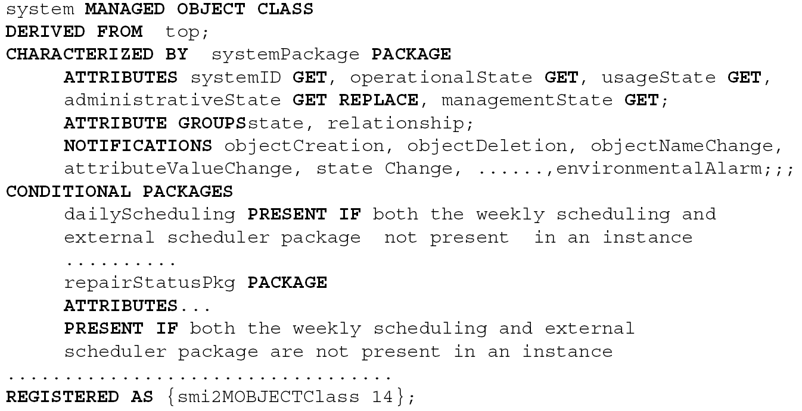
Source: IEEE Communications Magazine • May 1993

Slide 35
Packet Counter Example

Slide 36
Internet vs. OSI Managed Object
Scalar object (Internet) vs. Object-oriented (OSI)
Operations, behavior, and notification in OSI are part of communication model in Internet: get/set and response/alarm
Internet syntax is absorbed as part of OSI attributes
Internet access is part of OSI security model
Internet status is part of OSI conformance application
OSI permits creation and deletion of objects; Internet does not: Enhancement in SNMPv2

Slide 37
4. Communication Model
OSI: Operations ⬅➔ Internet: Request/Response
OSI: Notifications ⬅➔ Internet: Traps/Notifications

Slide 38
Transfer Protocols
c-l vs. c-o/c-l

Slide 39
5. Functional Model

Slide 40
6. Abstract Syntax Notation One: - ASN.1
ASN.1 is more than a syntax; it’s a language
Addresses both syntax and semantics
Two type of syntax
Abstract syntax: set of rules that specify data type and structure for information storage
Transfer syntax: set of rules for communicating information between systems
Makes application layer protocols independent of lower layer protocols
Can generate machine-readable code: Basic Encoding Rules (BER) is used in management modules

Slide 41
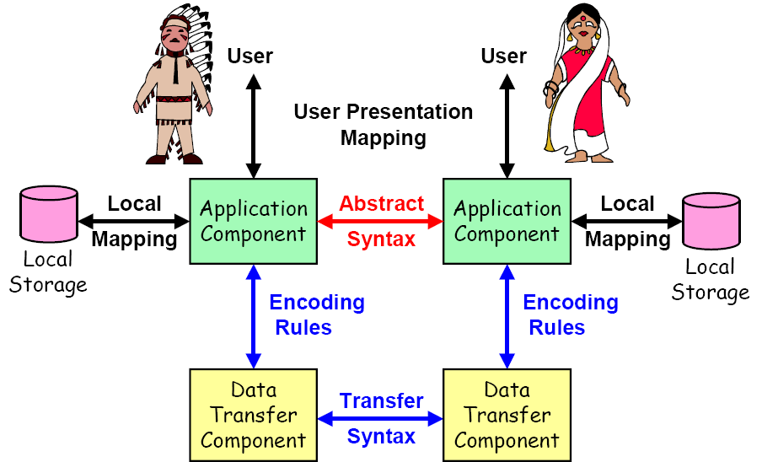
Abstract Syntax & Transfer Syntax
http://www.strongsec.com/zhw/KSy_ASN1.pdf

Slide 42
Backus-Nauer Form (BNF)
(Production)
Definition:
<name> ::= <definition>
Rules:
<digit> ::= 0|1|2|3|4|5|6|7|8|9
<number> ::= <digit> | <digit><number>
<op> ::= +|-|x|/
<SAE> ::= <number>|<SAE>|<SAE><op><SAE>
Example:
9 is primitive 9
19 is construct of 1 and 9
619 is construct of 6 and 19

Slide 43
Data Type and Value
Assignments
<BooleanType> ::= BOOLEAN
<BooleanValue> ::= TRUE | FALSE
Primitive ASN.1 data types in SNMPv1
INTEGER
OCTET STRING
OBJECT IDENTIFIER
NULL
All in Capital letters ➔ keywords

Slide 44
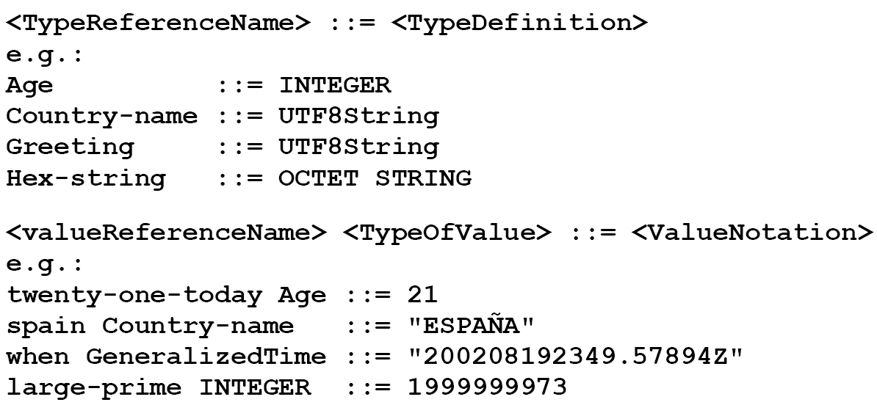
Type and Value Assignments

Slide 45
Subtype
Syntax: <subtype name> ::= <type> ( <constraint> )
Examples:
Counter ::= INTEGER ( 0..4294967295 )
IpAddress ::= OCTET STRING ( SIZE(4) )
Spring ::= Months ( march | april | may )
Summer ::= Months ( june | july | august )
SmallPrime ::= INTEGER ( 2 | 3 | 5 | 7 | 11 )
ExportKey ::= BIT STRING ( SIZE(40) )

Slide 46
ASN.1 Data Types
Basic Types
BOOLEAN, INTEGER, BIT STRING, OCTET STRING, NULL, OBJECT IDENTIFIER, REAL, ENUMERATED, NumericString, PrintableString, IA5String, UTCTime, GeneralizedTime, CharacterString
Constructed Types
CHOICE
SEQUENCE, SEQUENCE OF
SET, SET OF

Slide 47
Example
Married ::= BOOLEAN
Age ::= INTEGER
Picture ::= BIT STRING
Form ::= SEQUENCE {
name PrintableString,
age Age,
married Married,
marriage-certificate Picture
}

Slide 48
Example
Payment-method ::= CHOICE {
check Check-number,
credit-card SEQUENCE {
number Card-number,
expiry-date Date
}
}

Slide 49
Data Type: Example 1
PersonnelRecord ::= SET
{ Name,
title GraphicString,
division CHOICE {
marketing [0] SEQUENCE
{Sector,
Country},
research [1] CHOICE
{product-based [0] NULL,
basic [1] NULL},
production [2] SEQUENCE
{Product-line,
Country }
}
}
Tag

Slide 50
Data Type: Example 2
Trade-message ::= SEQUENCE
{ invoice-no INTEGER,
name GraphicString,
details SEQUENCE OF
SEQUENCE
{ part-no INTEGER,
quantity INTEGER },
charge REAL,
authenticator Security-Type
}

Slide 51
Enumerated Integer
IpRouteType ::=
INTEGER {
other(1),
invalid(2),
direct(3),
indirect(4)
}
Notes:
51

Slide 52
Object Name
internet OBJECT IDENTIFIER ::= { iso(1) org(3) dod(6) internet(1) }
private OBJECT IDENTIFIER ::=
{ internet 4 }
The object identifier (OID) of internet
is 1.3.6.1
The object identifier (OID) of private
is 1.3.6.1.4
Notes:
52

Slide 53
ASN.1 Module
ASN.1 module is a group of assignments
person-name Person-Name ::=
{
first "John",
middle "I",
last "Smith"
}
person-name ➔ module name
Person-name ➔ module

Slide 54
Module
<module name> DEFINITIONS ::= BEGIN
<name> ::= <definition>
<name> ::= <definition>
…
<name> ::= <definition>
END

Slide 55
ASN.1 Keyword Examples
CHOICE List of alternatives
SEQUENCE Ordered list maker
SEQUENCE OF Ordered array of repetitive data
SET Unordered list maker
SET OF Unordered list of repetitive data
INTEGER Any negative or non-negative number
NULL A placeholder
OCTET STRING String of octets (8-bit bytes)
OBJECT IDENTIFIER A sequence of non-negative numbers to uniquely identify an object

Slide 56
ASN.1 Symbols
Symbol Meaning
::= Defined as
| or, alternative, options of a list
- Signed number
-- Following the symbol are comments
{} Start and end of a list
[] Start and end of a tag
() Start and end of subtype
.. Range

Slide 57
ASN.1 Data Type Conventions
Data Types
Convention
Example
Object name
Initial lowercase letter
sysDescr, etherStatsPkts
Application data type
Initial uppercase letter
Counter, IpAddress
Module
Initial uppercase letter
PersonnelRecord
Macro, MIB module
All uppercase letters
RMON-MIB
Keywords
All uppercase letters
INTEGER, BEGIN

Slide 58
Data Type:
Structure & Tag
Structure defines how data type is built
Tag uniquely identifies the data type

Slide 59
Structure
Simple
PageNumber ::= INTEGER
ChapterNumber ::= INTEGER
Structured / Construct
BookPageNumber ::= SEQUENCE {ChapterNumber, Separator, PageNumber}
Tagged
Derived from another type; given a new ID
In Fig. 3-14, INTEGER is either universal or application specific
Other
CHOICE, ANY

Slide 60
Structured Type
SEQUENCE
Ordered list maker
SEQUENCE OF
Ordered array of repetitive data
SET
Unordered list maker
SET OF
Unordered list of repetitive data

Slide 61
Tag
Tag uniquely identifies a data type
Comprises class and tag number
Class:
Universal - always true
Application - only in the application used
Context-specific - specific context in application
Private - used extensively by commercial vendors

Slide 62
Tag Examples
BOOLEAN Universal 1
INTEGER Universal 2
PageNumber [APPLICATION 3]
product-based Context-specific under
research [0]
Counter ::=
[APPLICATION 1] INTEGER (0..4294967295)

Slide 63
Informal description of personnel record
Name: John P Smith
Title: Director
Employee Number 51
Date of Hire: 17 September 1971
Name of Spouse; Mary T Smith
Number of Children 2
Child Information
Name Ralph T Smith
Date of Birth 11 November 1957
Child Information
Name Susan B Jones
Date of Birth 17 July 1959

Slide 64
ASN.1 description of the record structure
PersonnelRecord ::= [APPLICATION 0] IMPLICIT SET {
Name,
title [0] VisibleString,
number EmployeeNumber,
dateOfHire [1] Date,
nameOfSpouse [2] Name,
children [3] IMPLICIT SEQUENCE OF ChildInformation DEFAULT { }
}
ChildInformation ::= SET {
Name,
dateOfBirth [0] Date }
Name ::= [APPLICATION 1] IMPLICIT SEQUENCE {
givenName VisibleString,
initial VisibleString,
familyName VisibleString }
EmployeeNumber ::= [APPLICATION 2] IMPLICIT INTEGER
Date ::= [APPLICATION 3] IMPLICIT VisibleString
-- YYYYMMDD

Slide 65
ASN.1 description of a record value
{
{givenName “John”, initial “T”, familyName “Smith”},
title “Director”
number “51”
dateOfHire “19710917”
nameOfSpouse {givenName “Mary”, initial “T”, familyName “Smith”},
children
{ { {givenName “Ralph”, initial “T”, familyName “Smith”},
dateOfBirth “19571111”
},
{ {givenName “Susan”, initial “B”, familyName “Jones”}
dateOfBirth “19590717”
}
}
}

Slide 66
7. BER Encoding
BER (Basic Encoding Rule)
TLV Encoding Structure
T: Tag
P/C: Primitive/Construct
0/1

Slide 67
TLV
Primitive:
INTEGER
T
L
V
Construct:
SEQUENCE
T
L
T
L
V
T
L
V
V

Slide 68
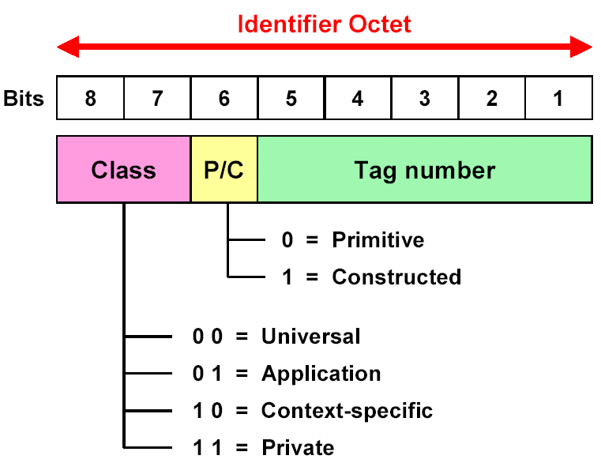

Slide 69
Universal Class Tag
Binary Hex Tag Tag Name
00 0 00010 02
00 0 00100 04
00 0 00101 05
00 0 00110 06
00 1 10000 30
Universal 2 INTEGER
Universal 4 OCTET STRING
Universal 5 NULL
Universal 6 OBJECT IDENTIFIER
Universal 16 SEQUENCE / SEQUENCE OF
Page 127

Slide 70
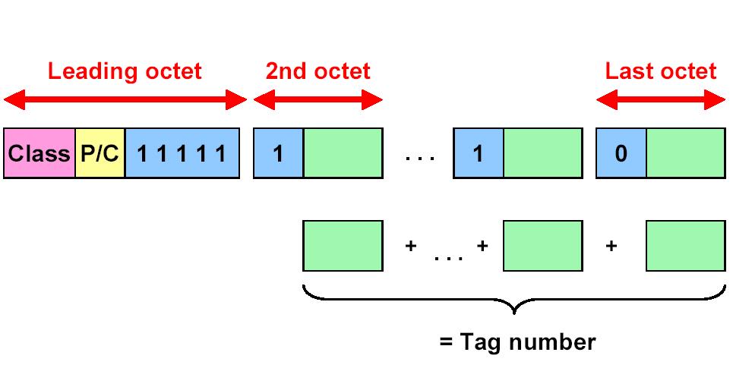
Tag numbers ≥ 31

Slide 71
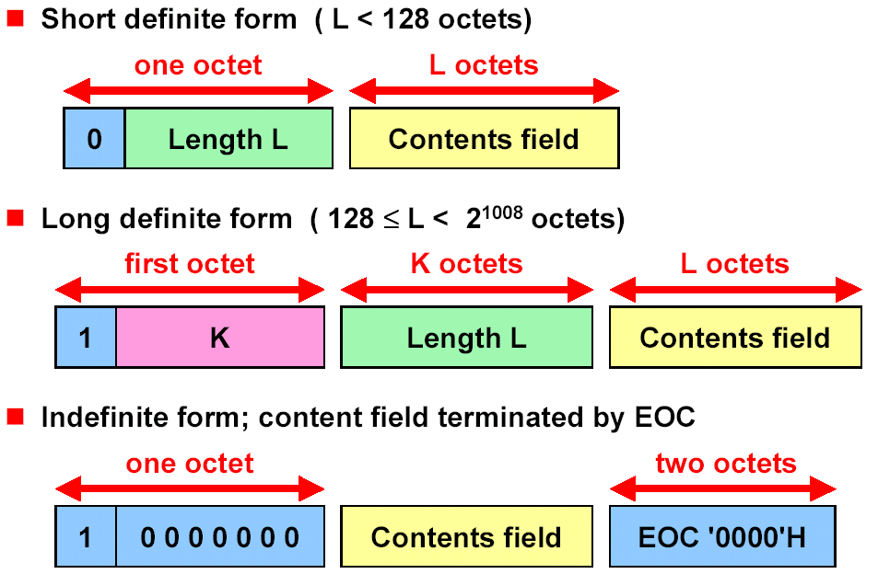

Slide 72
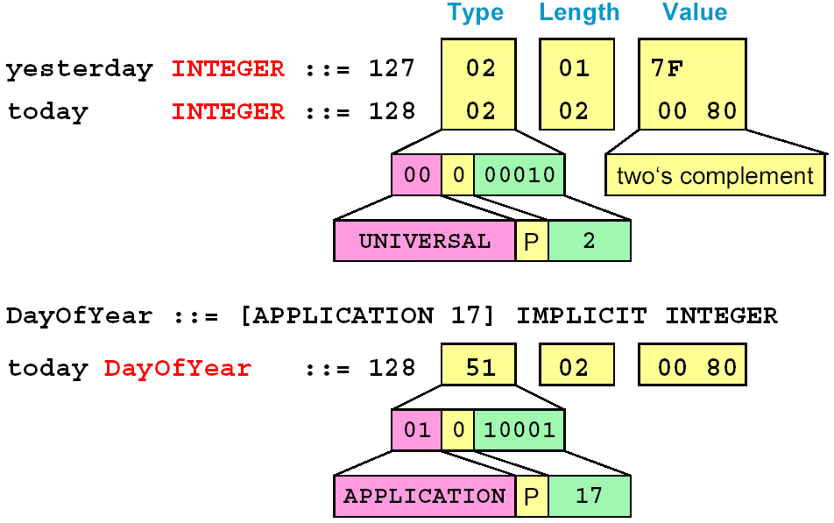
1000 0000

Slide 73
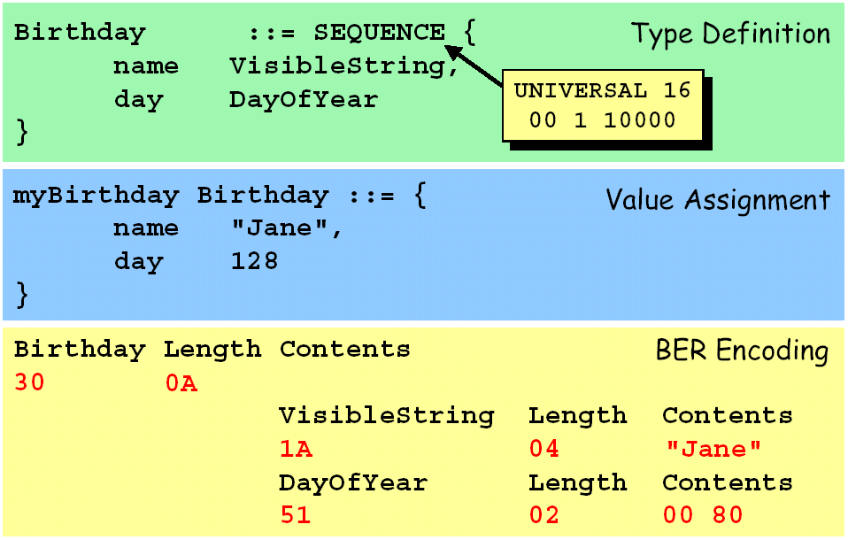
30 0A 1A 04 4A 61 6E 65 51 02 00 80

Slide 74
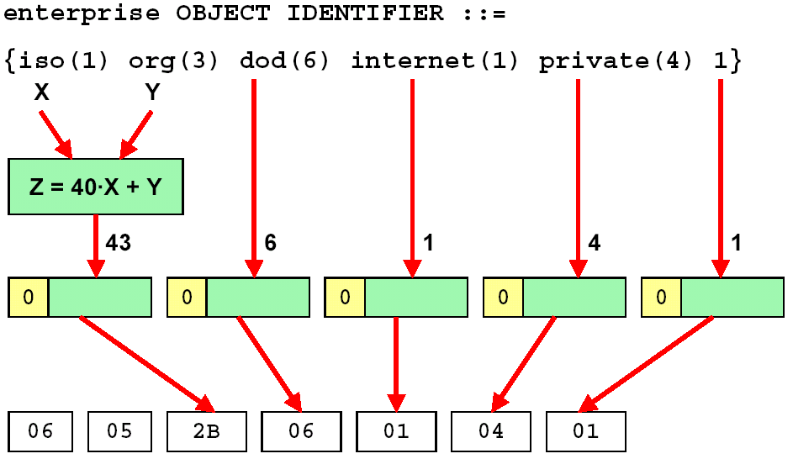

Slide 75
Example: SNMP Message
Tag
Message ::= SEQUENCE {
version INTEGER {
version-1(0)
},
community OCTET STRING,
data ANY
}
30
02
04

Slide 76
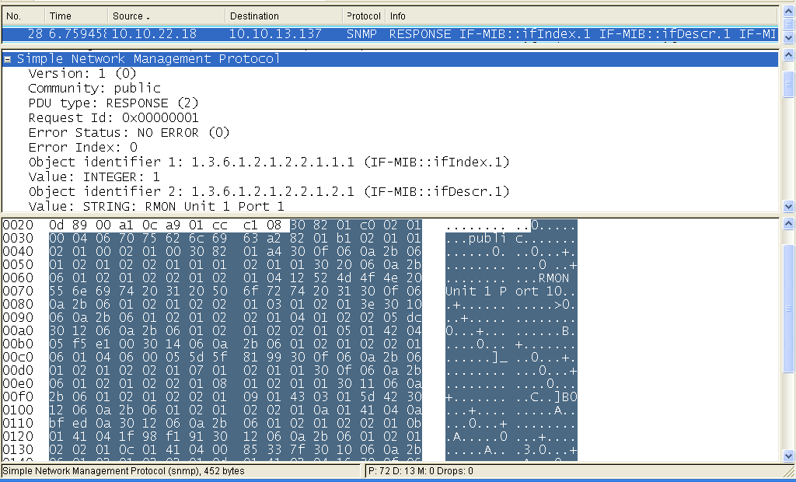
Example: SNMP Message
Type ➔ 30: SEQUENCE
Length ➔ 82 01 c0: 448 octets
82: 10000010

Slide 77
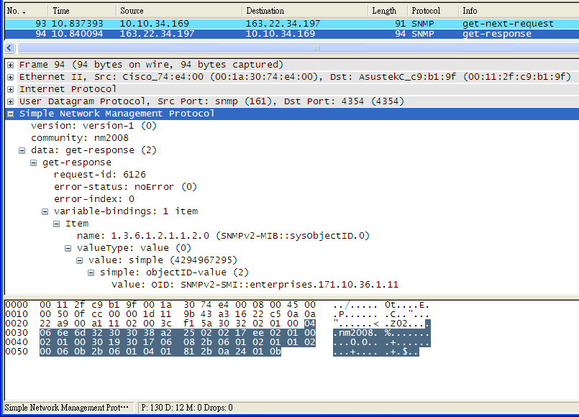
Type ➔ 30: SEQUENCE
Length ➔ 32: 50 octets

Slide 78
8. Macros
<macroname> MACRO ::=
BEGIN
TYPE NOTATION ::= <syntaxOfNewType>
VALUE NOTATION ::= <syntaxOfNewValue>
<auxiliaryAssignments>
END

Slide 79
Macro Example
OBJECT-TYPE MACRO ::= BEGIN
TYPE NOTATION ::= "SYNTAX" type (TYPE ObjectSyntax)
“ACCESS" Access
"STATUS" Status
VALUE NOTATION ::= value (VALUE ObjectName)
Access ::= "read-only" | "read-write“ | "write-only | "not-accessible"
Status ::= "mandatory” | "optional“ | "obsolete"
END

Slide 80
Object-Type Example
sysName OBJECT-TYPE
SYNTAX DisplayString (SIZE (0..255))
ACCESS read-write
STATUS mandatory
::= { system 5 }

Slide 81
Marco Example 2
CAR MACRO::= BEGIN
TYPE NOTATION ::= Brand Engine CarType Year
VALUE NOTATION ::= value (VALUE OBJECT IDENTIFIER)
Brand ::= “BRAND” value (PrintableString)
Engine ::= “CC” Ccs
Ccs ::= Cc | Ccs”,” Cc
Cc ::= value (INTEGER (600..5000))
CarType ::= “STYLE” CType
CType ::= “Sedan” | “Liftback” | “SUV” | “Other”
Year ::= “YEAR” value (INTEGER)
END

Slide 82
Camry CAR
BRAND Toyota
CC 2000, 2400, 3000
STYLE Sedan
YEAR 2006
::= {toyota 3}

